Slide 1
Deep Neural Networks
Notes:
We’ll start with a discussion of how DNNs enable an entirely new way of solving problems.

Slide 2
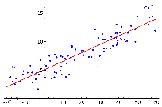
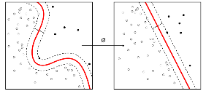
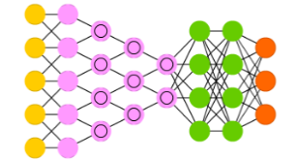
Difference in Workflow
Examples [ Regression and SVMs ]
Classic Machine Learning [ 1990 : now ]
Hand Designed Features
Model / Mapping
Input
Output
Deep/End-to-End Learning [ 2012 : now ]
Example [ Conv Net ]
Simple Features
Complex Features
Model/ Mapping
Input
Output
Notes:
Traditionally, in order to solve any problem with computing, you’d need to become or hire a domain expert in the problem you’re working to solve. You’d identify an ideal solution, and then translate that solution to steps in a language a computer could follow. An engineer would write an algorithm.
The main difference in workflow which we’ll keep returning to throughout this course is the mindset of learning the algorithm from data. Now, we need a large dataset of inputs and their corresponding outputs. What does this mean?
Let’s take a look at the diagram on the right.
This is the first of many of these that you’ll see throughout this course. This is an abstracted view of a neural network. While there are endless conversations that we can have about how they work, we’re going to start by inspecting their inputs and outputs. To make this concrete, let’s imagine we are looking at the neural network that powers a self-driving car.
Let’s start with the outputs, which are represented here on the right in orange. If you think about it, we only control three variables when we drive: gas pressure, brake pressure, and steering angle. On the left-hand side, you can see the inputs. What inputs inform our own driving? Our sensory data: how far we can see, our reading of the speed limit or stop sign, our kid throwing something in the back seat. Our self-driving cars are equipped with sensors that learn as much as they can about the conditions around the car.
Our “data” consists of input and output data. Millions of miles driven in a car outfitted with sensors creates a dataset of sensory data and the corresponding output of the driver. Over time, enough of that data trains the neural network to respond appropriately to new data. This is a big deal.

Slide 3

Difference in Workflow
Examples [ Regression and SVMs ]
Classic Machine Learning [ 1990 : now ]
Hand Designed Features
Model / Mapping
Input
Output
Challenge: How would you give instructions to differentiate the handwritten digit on the right from other digits to:
A two-year-old child learning numbers OR
A computer using any programming language (including pseudocode)
Answer in discussion section– 3 minutes
Notes:
Without DNNs, we’d have to write programs. Take a few minutes to feel the pain of teaching computers to see without it. When I say go, turn to the person next to you and introduce yourself. Attempt to talk through a step by step program that will translate from raw pixels to the fact that this symbol represents the number 2.
You can pick your audience: a two year old who is learning about numbers OR a computer using any programming language (pseudocode is ok).
Take 3 minutes. [Actually time this…bring them back together and ask for a few exceptional ideas. This should be fun.]

Slide 4
First hands-on section
Train a Human Learner
Train a Machine Learner
Notes:
At this point, you are preparing to release students to a hands-on section. They will first play a game: The Louie Classifier, then come back to discuss, then train a neural network to perform the same task. Tell them that:)

Slide 5
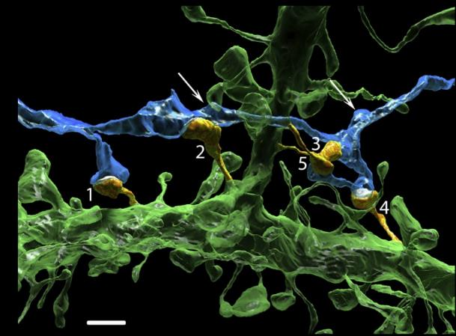
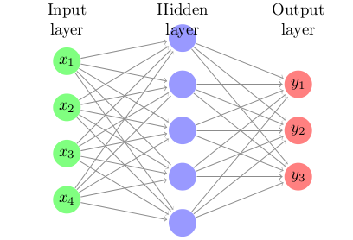
Biological Inspiration
Notes:
We started with this game to help you understand how Deep Learning is similar to human learning. In the next section, you’ll train a neural network to communicate the same thing. We’ll come back together after training the network to connect the two.

